Slide 2
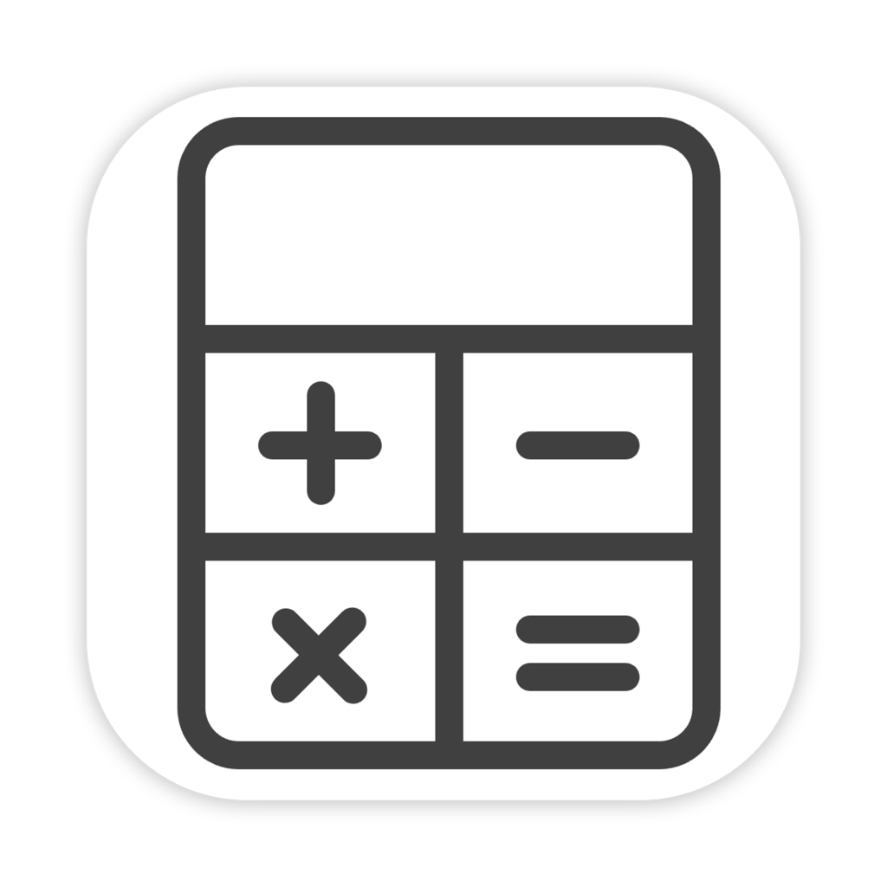

Slide 3
zero

Slide 4
zero
0

